Slide 1


Welcome to BbB!
Bit by Bit

Slide 2
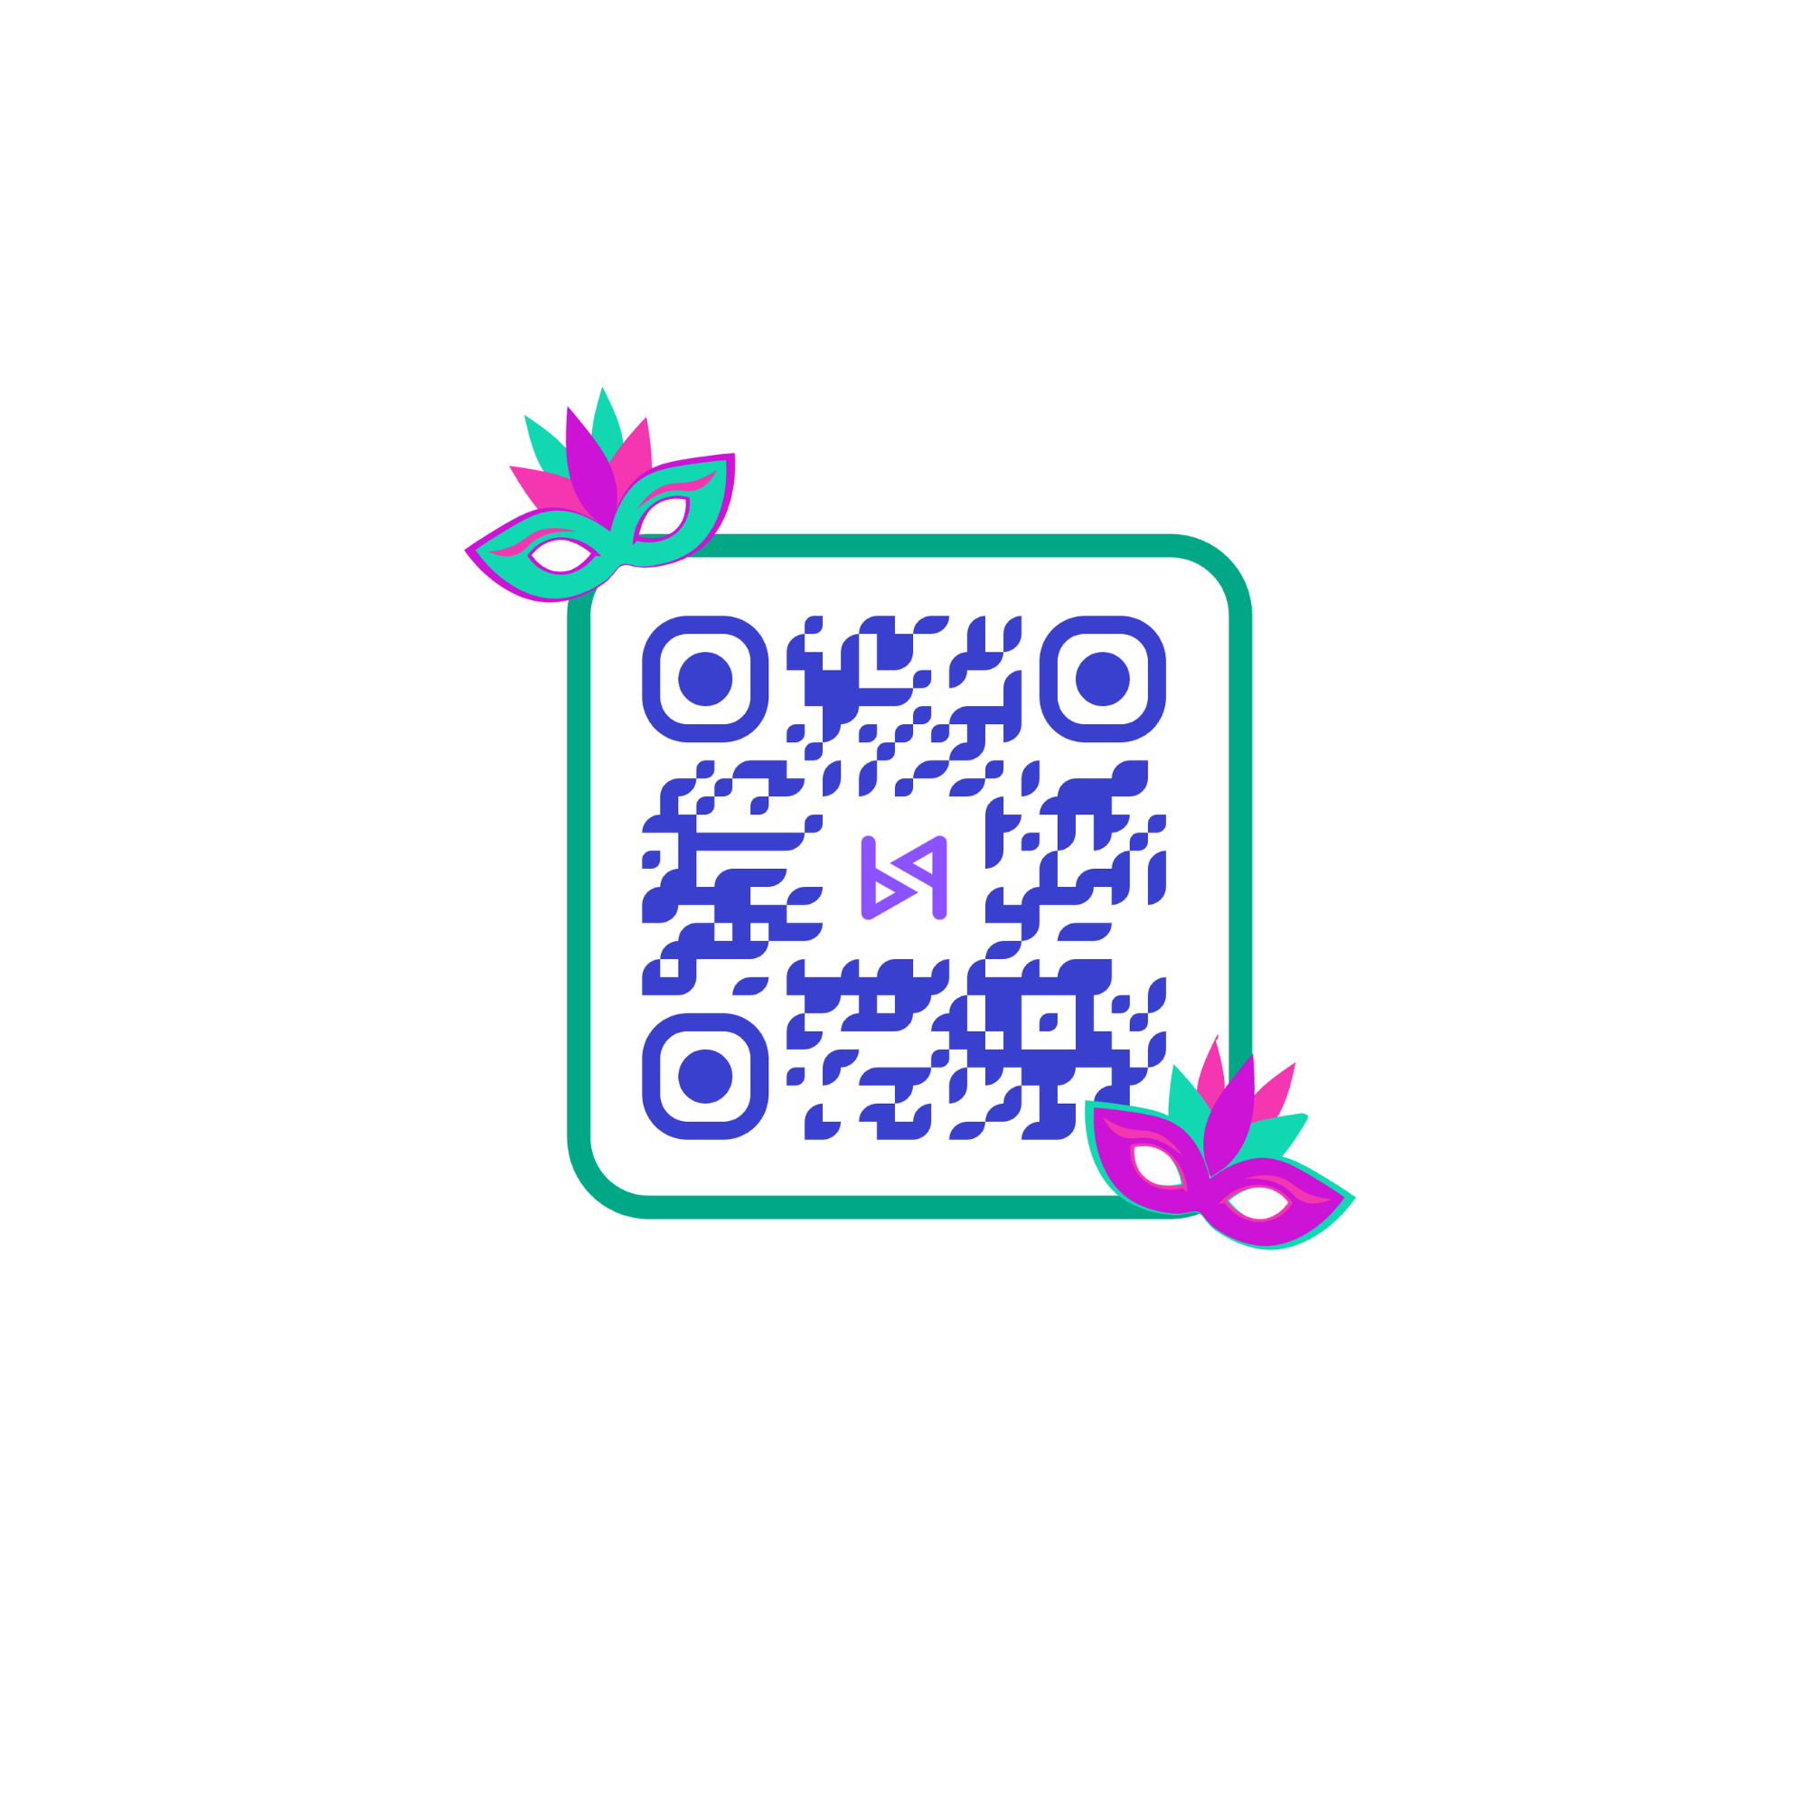
WIFI
*ScapeWi-Fi
PASSWORD: iheartorange
Attendance
Bit by Bit

Slide 3

Bit by Bit
Mission Statement
Who we are
What we do
Why we do it
We provide free coding and STEM lessons for teens aged 13 to 18, empowering them to create something amazing in their own lives.
Coding in Singapore is an expensive hobby. Private enrichment classes in coding and robotics are pricey, remaining out of reach for many middle and lower-income children and teenagers.
BbB a group of students and volunteers seeking to make a difference in STEM and coding education in Singapore.

Slide 4



Bit by Bit
Our Partners!

Slide 5
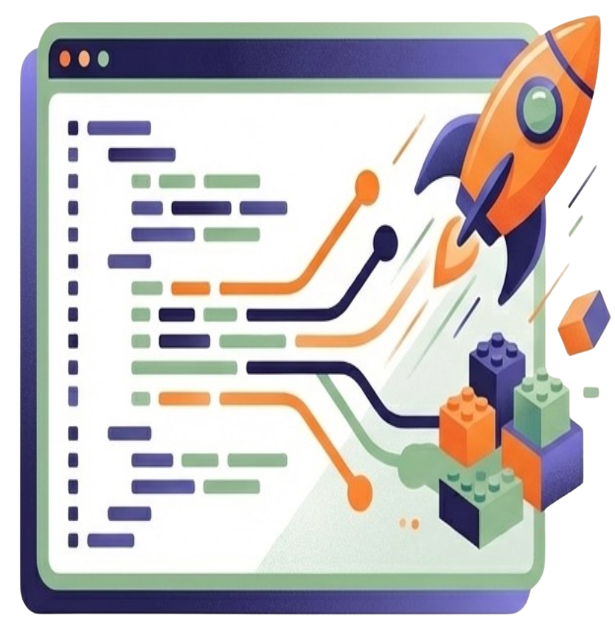
Bit by Bit
Learning by Making
No Boring Slides
We prioritise creating visible, working code over passive theory.
Live Coding Demonstrations
Tutors code alongside you, showing immediate results and narrating their thought process
Just-in-Time Learning
Programming concepts are introduced exactly when you need them to complete your projects, making abstract ideas immediately relevant.

Slide 6
Bit by Bit
Lesson Structure
0:00 - 0:15
0:15 - 1:15
1:15 - 1:30
1:30 - 2:00
2:00 - 2:50
2:50 - 3:00
Administrative
Attendance
Recap of previous session
Demo
New concept introduction + micro-challenges
Live coding demo by tutor
Break
Demo
Continue with demo
Collaborative Challenge
Students work together to solve challenges
Wrap-up
Optional Homework Assignment
Preview of next session

Slide 7
Bit by Bit
12-week Plan: Python
1 | 2 | 3 | 4 | 5 | 6
Python Basics | Loops | Data Structures | Functions & Recursion | File IO | Data Representation

Slide 8
Bit by Bit
12-week Plan: Python
7 | 8 | 9 | 10 | 11 | 12
Searching & Sorting | OOP | Grand Challenge | Build Week | Presentation and Evaluation | Knowledge Expander

Slide 9
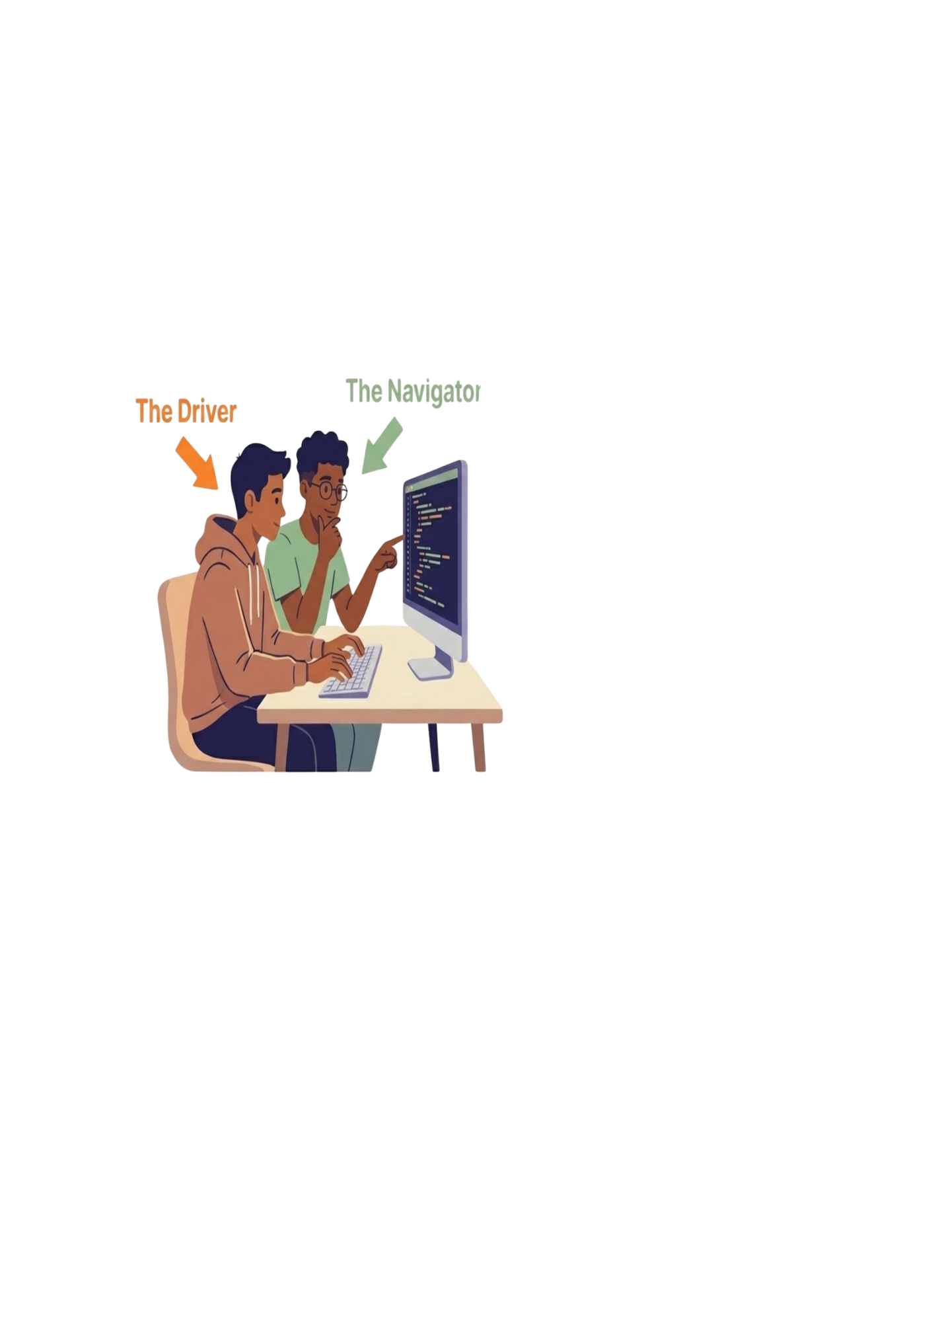
Bit by Bit
The Power of Pair Programming
The Navigator
The Driver
The Driver: Controls the keyboard and types the code.
The Navigator: Reviews the code, asks questions, and thinks ahead to the next step.
The Rotation: Roles swap every 10-15 minutes
The Benefit: Reduces anxiety, enables peer teaching, improves code quality, and builds professional collaborative norms.

Slide 10


Bit by Bit
Debugging is a Superpower
Mistakes are intentional
Tutors will intentionally make coding errors during live demos to show you how to fix them.
Not Yet
We replace “I can’t” to “ I haven’t solved this YET.”
Peer Support
The “Ask Three Before Me” rule. Consult resources and peers before the tutor.
Systematic Problem Solving
You will learn how to read error messages, test hypotheses, and print values to find solutions

Slide 11
Bit by Bit
Let’s get started!
Link to Google Drive: https://tinyurl.com/12-weekpython

Slide 12
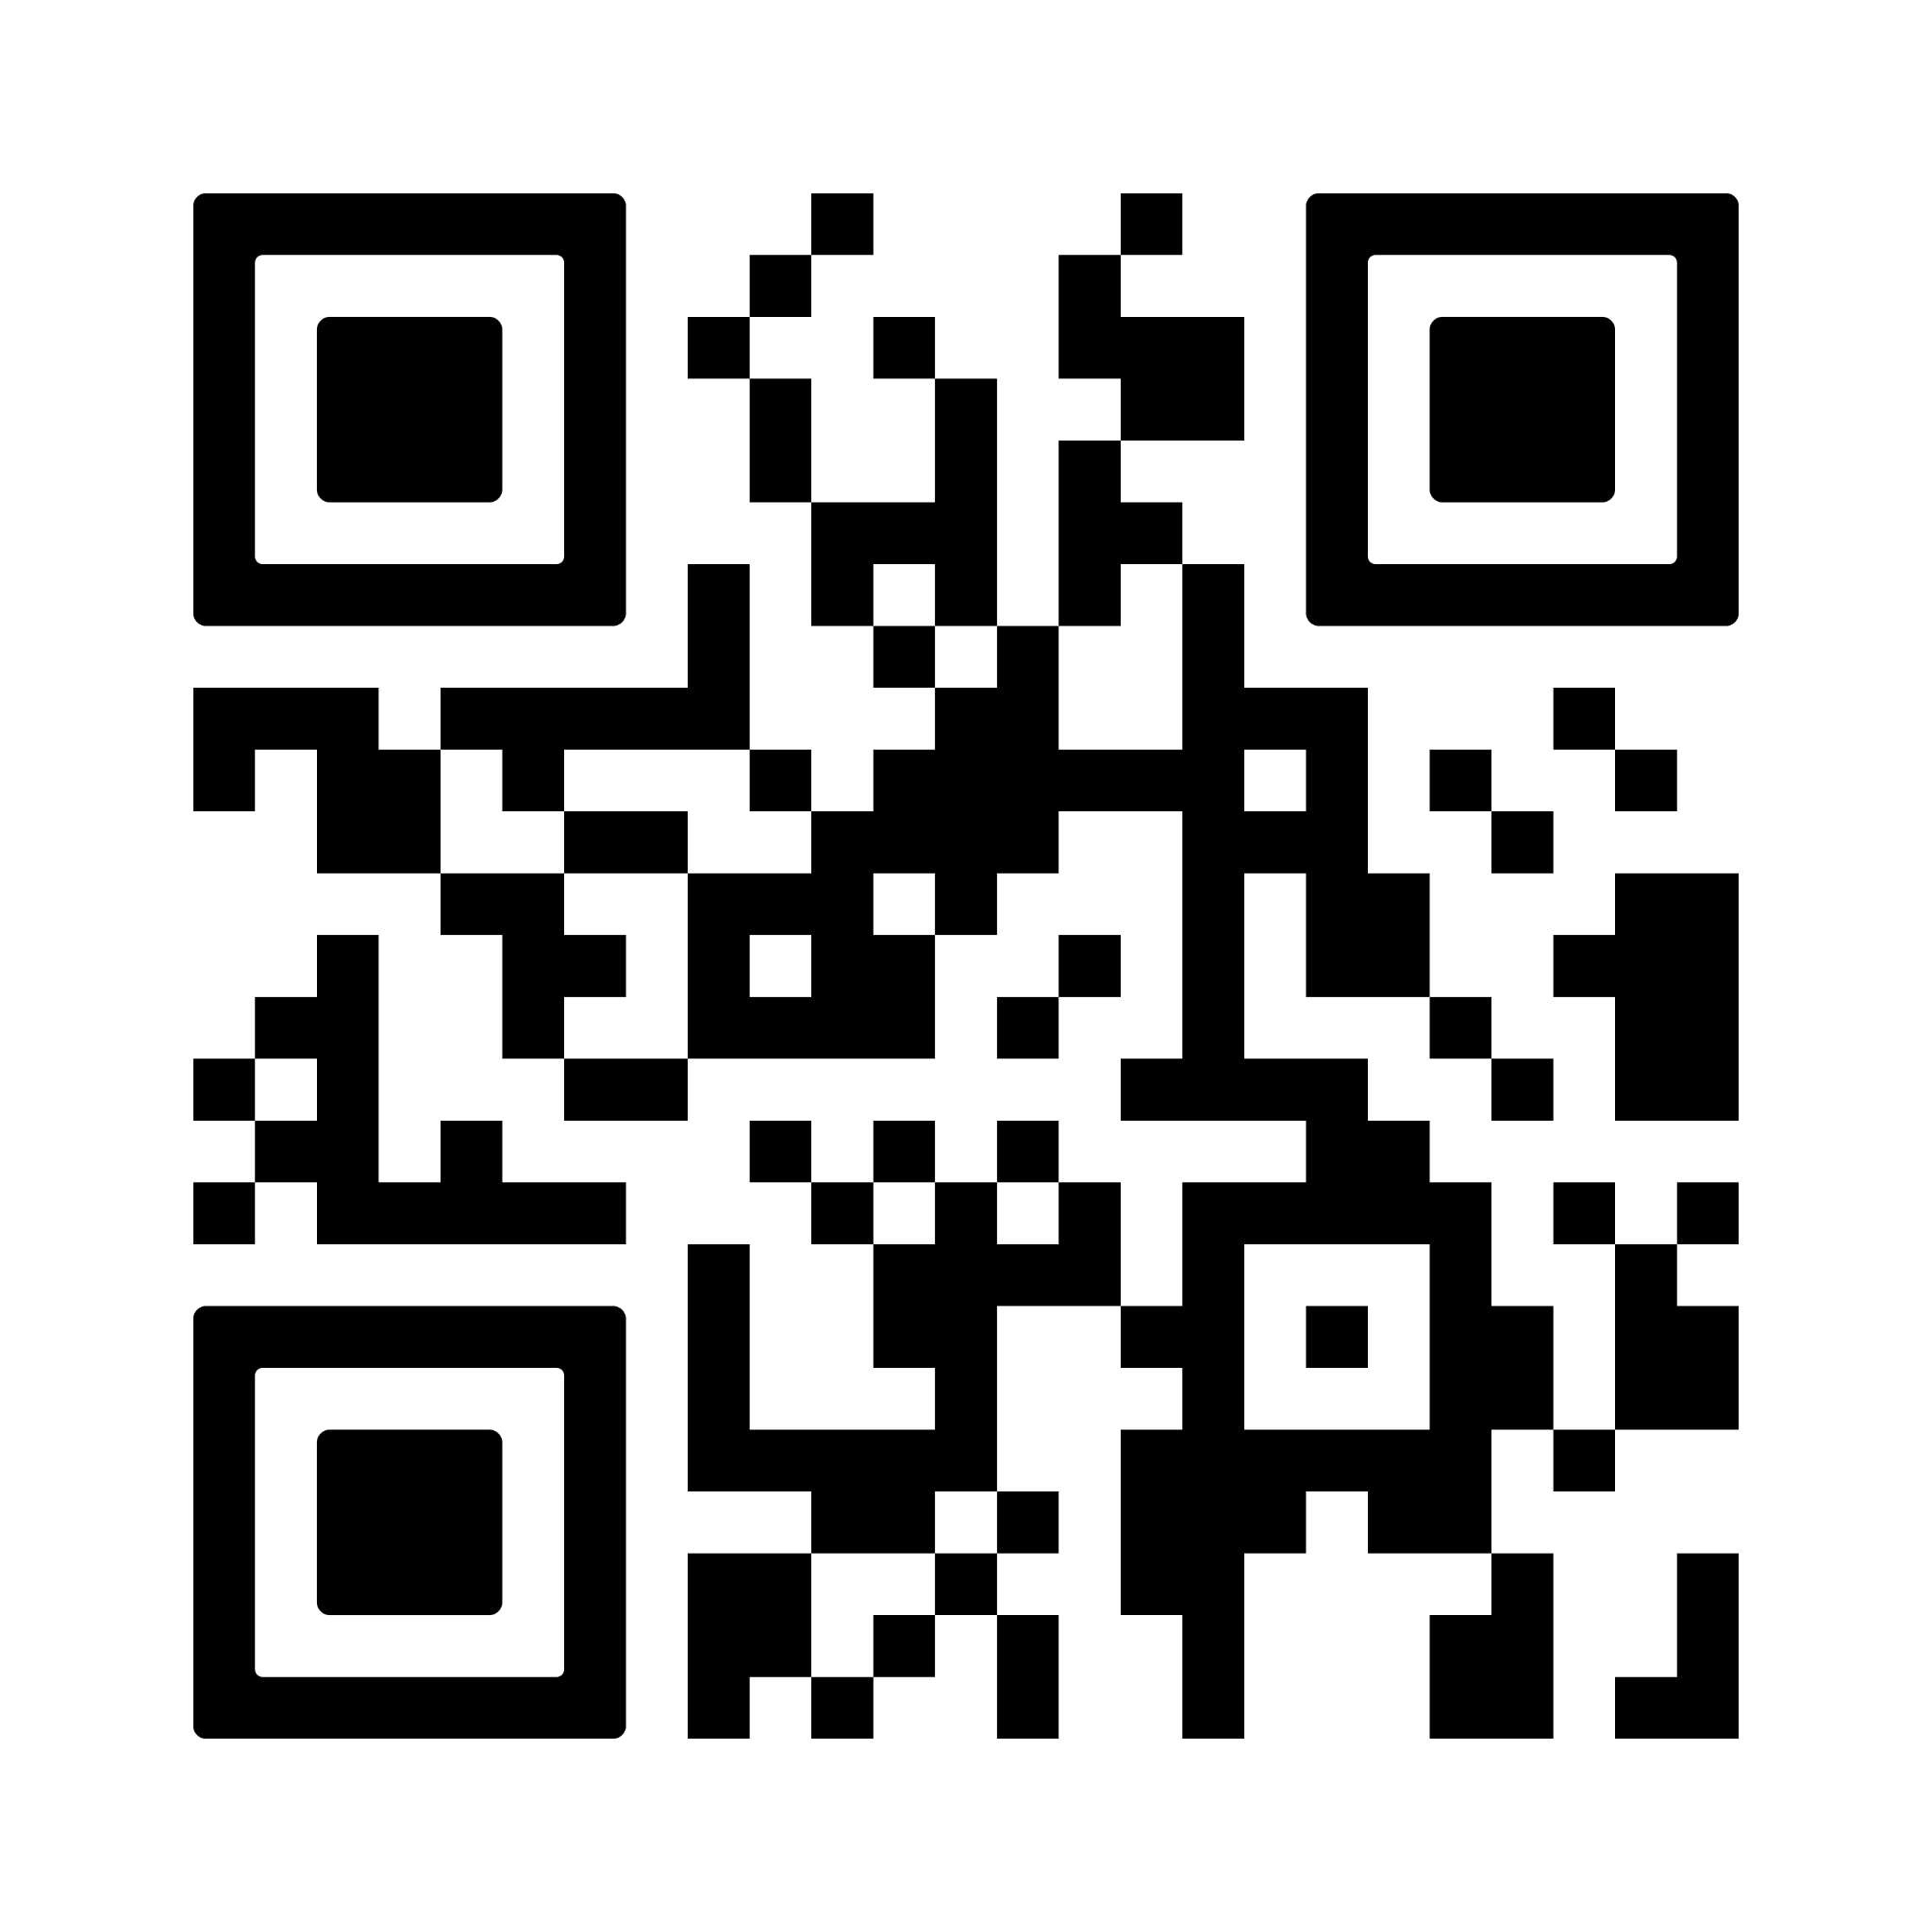
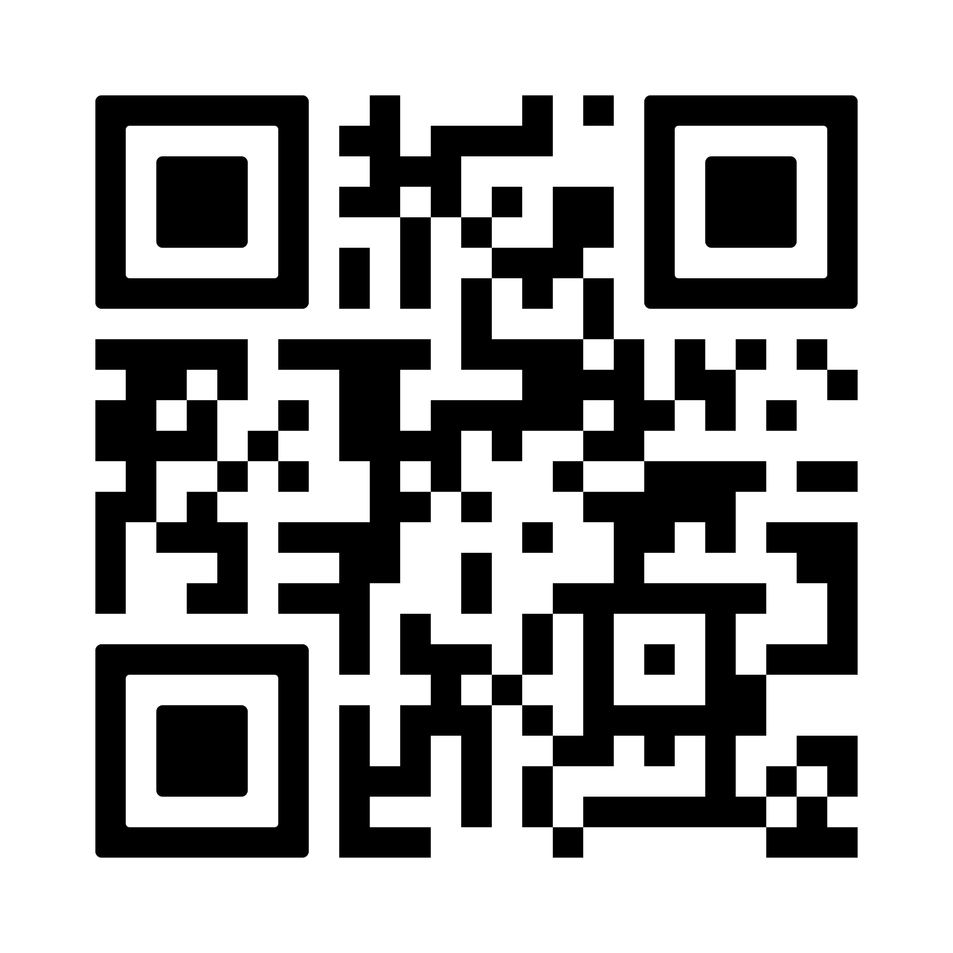
Bit by Bit
Educado
A free tutoring initiative that connects volunteer tutors with students (from secondary to JC) who need academic support! 🎓
Tutee Sign up
Tutor Sign up

Slide 13

Educado Tutee Sign up
Any Questions?
Educado Tutor Sign up
Tutor Sign up

Slide 14

Thank You!
‹#›

